Slide 1
Energy Tax Update
Cost Approach Prevails in
Alta Wind
July 2026

Slide 2



Speakers
John Eliason
Washington, D.C.
Wolf Pohl
San Francisco
Mark Christy
Chicago

Slide 3
Today's Agenda
Case Background
Section 1060 Framework
Why the Court Rejected Plaintiffs' DCF Valuation Approach
The Cost Approach and Key Adjustments
Relevance to ITCs (Section 48 and 48E)
California Ridge Revisited
Impact on Transactions Going Forward
Q&A

Slide 4
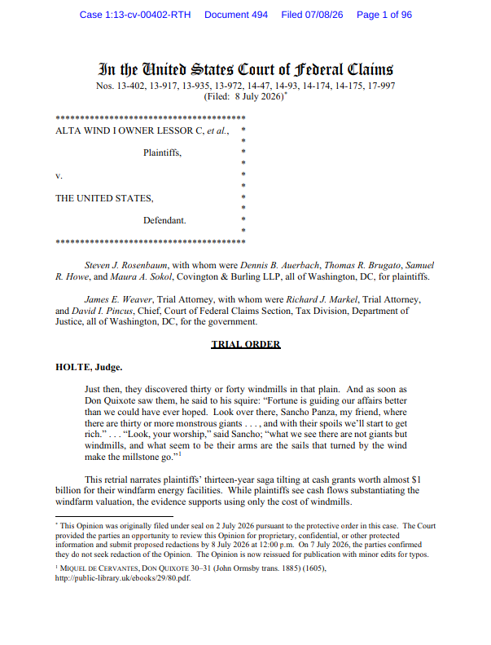
Alta Wind I Owner Lessor C, et al. v. United States
U.S. Court of Federal Claims, Nos. 13-402 et al. (Decision filed July 8, 2026)

Slide 5
Overview of Valuation Methodologies
Income Approach (DCF)
  Projects future cash flows, discounted to present value
  Requires reliable forecast data; widely accepted for income-producing assets
  Risk: must reliably strip out intangible/tax-benefit value from cash flows
Cost Approach
  Values reproduction/replacement cost of the asset
  Cost basis + developer profit markup
  Preferred for readily replicable, itemized assets
Market Approach
  Values based on comparable arm's-length transactions
  Requires sufficiently comparable market data
  Often not informative for unique or specialized energy assets
Choice of methodology is a factual determination based on the record, not a fixed legal rule

Slide 6
Cost Segregations
Itemizes total construction/development costs
Allocates costs between eligible and ineligible property
Establishes reproduction cost baseline for cost approach
Applies eligibility ratios line-by-line
Documentation quality determines reliability

Slide 7
Section 1060 Allocations
Seven-Class Residual Method (Treas. Reg. § 1.338-6(b))
  Class I: Cash
  Class II: Actively traded personal property/securities
  Class III: Debt instruments
  Class IV: Inventory
  Class V: Tangible property (turn-key value)
  Class VI: Section 197 intangibles (contract rights)
  Class VII: Goodwill / going concern
Sequential waterfall — allocated at fair market value

Slide 8
Using the Cost Approach - The Court's Operative Instructions
Start with KPMG Cost Segregation Reports
Exclude Development Rights
Include IDC + Oak Creek Development Fee
Apply Grant-Eligibility Ratios
No Independent Turn-Key Premium
Apply Developer Profit (15% Alta I / 20% Alta II-VI)
Result: FMV of Class V Assets x 30% = Cash Grant Value

Slide 9
Questions?

Slide 10



Thank you!
John Eliason
Washington, D.C.
Jeliason@orrick.com
+1.202.339.8546
Wolf Pohl
San Francisco
wpohl@orrick.com
+1.415.773.4252
Mark Christy
Chicago
mchristy@orrick.com
+1.312.924.9832

